Slide 1
Data Stuctures and Algorithms
Dr. Fidaa Abed

Slide 2
Array-Based Lists
Advantages:
Easy to access any element in the the array
Easy to change the value of any element in the array
Disadvantages
Fixed size. Adding more elemets might need expanision.
Adding an element I the middle need shifting.
Removing an element from the middile need shifting.

Slide 3
Array-Based List Operations
size()
get(i)
set(i,x)
add(i,x)
remove(i)

Slide 4
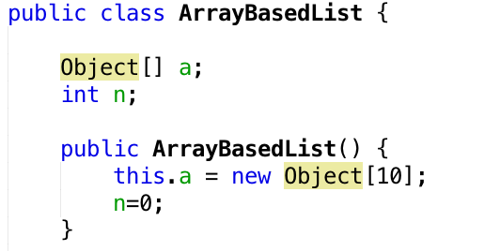
Fields and Constructor

Slide 5

size() method
O(1)

Slide 6

get(i) method
O(1)

Slide 7
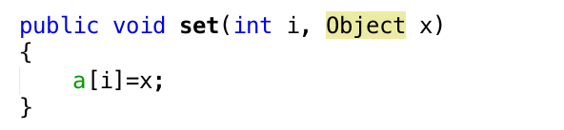
set(i,x) method
O(1)

Slide 8
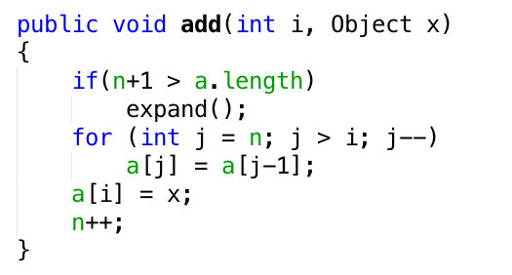
add(i,x) method
O(n-i)

Slide 9
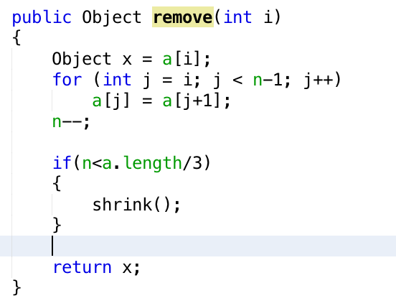
remove(i) method
O(n-i)

Slide 10
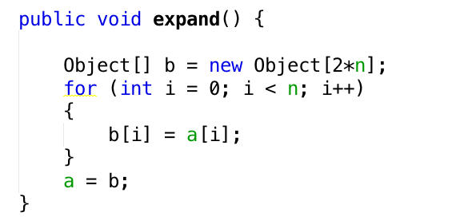
expand method
O(n)

Slide 11
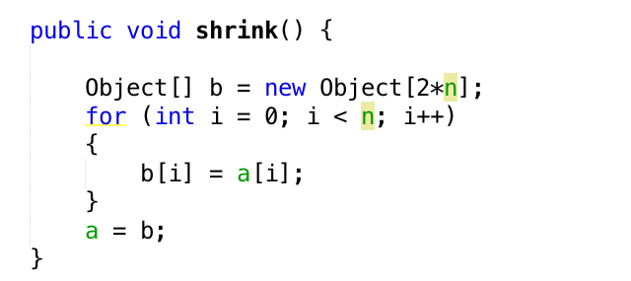
shrink method
O(n)

Slide 12
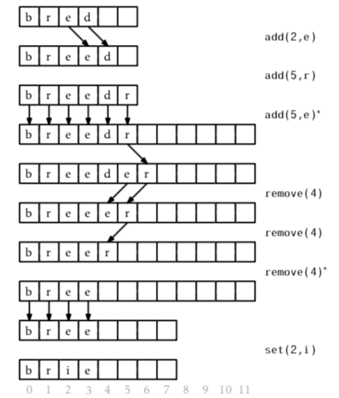
Example

Slide 13
Stack
pop() → remove(n-1)
push(x) → add(n,x)
O(1) for both operations

Slide 14
Exercise
Use the ArrayBasedList class as a stack to reverse an input String.

